Slide 1


CS-429 Introduction to Data Science
Lecture 04 - Intro to AI, ML
Fall 2024

Slide 2
Artificial Intelligence (AI)
A field of computer science that focuses on creating systems that can perform tasks that would normally require human intelligence.
These tasks include understanding language, pattern recognition, making decisions, and solving problems.
AI aims to build machines or programs that can think, learn, and adapt to new situations, making it possible for computers to mimic human abilities and cognitive function.

Slide 3
Key Branches of AI
Machine Learning (ML)
Linear Regression, KNN, K-mean clustering DT, SVM, etc.
Natural Language Processing (NLP)
Chatbots, Lang Translation, Sentiment Analysis, and Speech Recognition.
Computer Vision
Face Recognition, Autonomous Vehicles, and Medical Image Analysis.
Robotics
Robots use sensors, actuators, and AI algorithms to adapt to new situations.
Expert Systems
Designed to solve complex problems by simulating human expertise
Reinforcement Learning (RL)
It’s used in gaming, robotics, and complex problem-solving tasks.

Slide 4
Types of AI
AI can be divided into three main types based on capabilities:
Narrow AI (Weak AI):
Designed to perform a single task or a narrow set of tasks.
Examples: Voice assistants, recommendation systems, and image recognition.
General AI (Strong AI):
AI with human-like intelligence that can understand, learn, and decide.
This type doesn’t yet exist but remains a goal in AI research.
Superintelligent AI:
Hypothetical AI that surpasses human intelligence and capabilities.

Slide 5
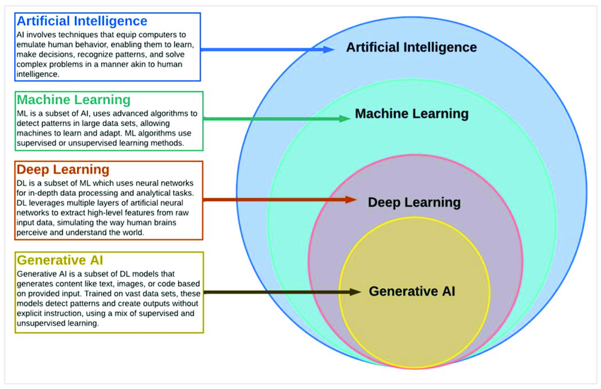

Slide 6
Machine Learning
Definition: Machine Learning (ML) algorithms used to create models that allow systems to learn from data and make decisions or predictions.
ML algorithms are classified into three main types based on how they learn from the data:
Supervised Learning
Unsupervised Learning
Reinforcement Learning.

Slide 7
Supervised Learning
Supervised Learning algorithms learn from labeled data, meaning each training example includes input data as well as the correct output (label).
The goal is to learn a mapping from inputs to outputs so that the model can predict the label for new, unseen data
Used for: Classification (categorizing data) and regression (predicting continuous values).

Slide 8
Algorithms of Supervised Learning
Linear Regression: Predicts continuous outcomes by fitting a line to the data.
Logistic Regression: Used for binary classification problems (e.g., spam or not spam).
Decision Trees: A flowchart-like structure where each internal node represents a feature, and each leaf node represents an outcome.
Support Vector Machine (SVM): Classifies data by finding the hyperplane that best separates different classes.
k-Nearest Neighbors (k-NN): Classifies data points based on the closest data points in the training set.
Naive Bayes: A probabilistic classifier based on Bayes’ theorem, often used in text classification.
Neural Networks: Models that mimic the human brain, especially useful for complex tasks like image recognition

Slide 9
Unsupervised Learning
Unsupervised Learning algorithms work with data that is unlabeled.
The model tries to identify patterns, groupings, or structures within the data on its own.
Unsupervised learning is often used for exploratory data analysis (EDA) and data segmentation.
Used for: Clustering (grouping similar data) and association (finding relationships in data).

Slide 10
Algorithms of Unsupervised Learning
K-Means Clustering: Divides data into k clusters, where each data point belongs to the cluster with the nearest mean.
Hierarchical Clustering: Builds a hierarchy of clusters, either by merging or splitting clusters iteratively.
Principal Component Analysis (PCA): Reduces the dimensionality of data by transforming it into a smaller number of principal components.
Association Rules (e.g., Apriori): Finds relationships between variables in large datasets, often used in market basket analysis.
Autoencoders: A type of neural network used to learn efficient data codings, primarily for dimensionality reduction.

Slide 11
Reinforcement Learning
Reinforcement Learning (RL) is a type of ML where an agent/model learns by interacting with an environment and receiving feedback through rewards or penalties.
The agent/model aims to maximize the cumulative reward over time by choosing the best actions.
RL is widely used in games, robotics, decision-making tasks, and sequential tasks

Slide 12
Algorithms of Reinforcement Learning
Q-Learning
Deep Q-Networks (DQN)
Policy Gradient Methods
Actor-Critic Methods
Proximal Policy Optimization (PPO)

Slide 13
In this course
Linear Regression (supervised)
K Nearest Neighbour (both)
K-mean Clustering (unsupervised)

Slide 14


Slide 15

The Purpose of Life – Prof. Jeffrey Lang
Concept of the first test of Hazrat Adam (A.S) in Jannah.
Cycle of life in this temporary world.
Which qualities do we need to build in ourselves?
URL: The Purpose of Life - Jeffrey Lang
Total Duration: 01:31 Hrs

